Slide 1
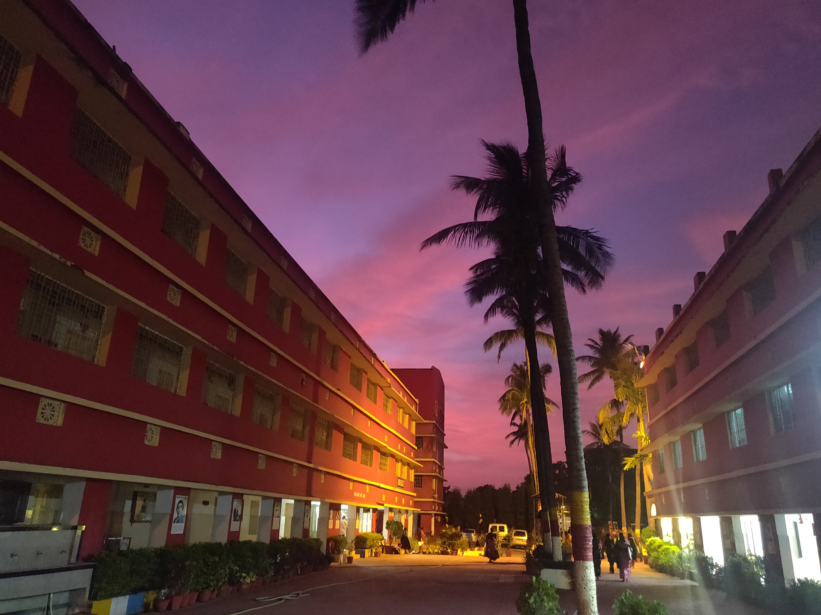
Subject : Mathematics
Topic : Subtraction
Class-iii

Slide 2
Learning Objectives
Children will able to :
Subtract bigger numbers.
Have idea about regrouping of subtraction.
Differentiate between Addition and Subtraction.
Write subtraction number sentence in word problems.
Identify the difference between subtraction and difference.
Calculate in easy ways.
Identify that when subtracting the highest number always goes first.

Slide 3
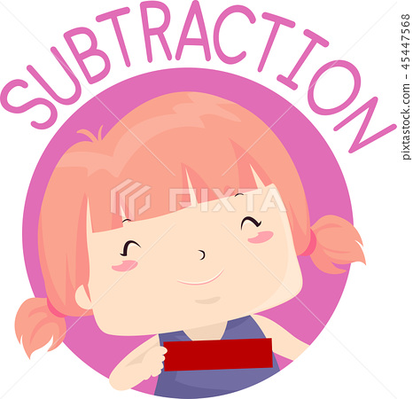
previous knowledge on subtraction
Lets ask the students regarding basic addition questions and word problem.
Lets answer it orally . Examples- 5+3=_____ Ans:8
A basket contain 3 oranges ,2 apples and 5 pomegranates. How many fruits are there in all? Now the students give the answer as 10. So now we learnt that addition is used in the phrases like total, add, sum, plus etc.
Then what about the phrases like taken away, remaining, left, how much more, minus ……?
Here we have to use subtraction.

Slide 4
Introduction
Subtraction is a math concept that looks at the process of removing things from a group.
You might take away a small piece from a big piece.
You will even learn to take away a value that is greater than your starting value.

Slide 5
MORE ABOUT SUBTRACTION
When subtraction is discussed, you will see minus (-) sign everywhere. That symbol stands for subtraction.
That sign means "to take away", "subtracting", or simply "minus."
When you do a word problem, you will see other phrases, including... • Lost • Gave away • Used up • Sold • Removed All of these terms might tell you that something was subtracted from your original amount.

Slide 6
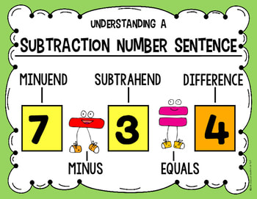
Terms used in subtraction

Slide 7
Properties of subtraction
Property 1- Zero property of subtraction
Here 0 is always taken as subtrahend. When we subtract 0 from a number the difference will be the number itself.
Example: 88-0=88
Property 2- If we subtract the number from itself i.e. both minuend and subtrahend are equal, then the difference is “0”.
Example: 45-45=0
Property 3 - Order of number is important that means minuend will come first in the subtraction.

Slide 8
Some Examples on subtraction
Q1) Subtract 3423 From 9879 Q2) Subtract 1020 From 9930
Th H T O Th H T O
9 8 7 9 9 9 3 0
(-) 3 4 2 3 (-) 1 0 2 0
6 4 5 6 8 9 1 0

Slide 9
Steps of subtraction & check
First subtract ones, next tens ,then hundreds lastly thousands and so on.
Examples Th H T O
9 8 7 4
(-) 1 5 2 0
8 3 5 4
To check, you have to add the subtrahend with the difference. If your result is the minuend then your subtraction is correct.
1 5 2 0
(+) 8 3 5 4
9 8 7 4
Minuend
Subtrahend
Difference

Slide 10
Subtraction With Regrouping

Slide 11
Learn subtraction with video

Slide 12
More About Regrouping

Slide 13
SUBTRACTION AND DIFFERENCE.
Subtraction is an operation which means we have to minus directly.
Example: 140 – 20 = 120
In difference we have to subtract smaller number from larger number
Example: Find the difference between 54 and 100.
Ans: Here 100 is our minuend and 54 is our subtrahend means we have to subtract 54 from 100.
1 0 0
(-) 5 4
0 4 6

Slide 14
Examples Of Subtraction With Our Day To Day Activities
We are using subtraction in many places like bank, market ,compare the things etc. Lets take some examples .

Slide 15
Word Problems
Q1) A shopkeeper had 808 eggs in his shop. He sold 530 eggs .How many eggs are remaining to be sold.
Q2)Sakshi wanted to buy a saree for ₹8755 but she had only ₹ 2990 with her. How much more money does she need ?
Answer : 7 16 15
Cost of saree = 8 7 5 5
Money with her (-) = 2 9 9 0
Money needed = 5 7 6 5
Answer: 7 10
Total number of Eggs = 8 0 8
Eggs sold (-) = 5 3 0
Eggs remaining = 2 7 8

Slide 16
CONCEPT MAP
SUBTRACTION
Take Away
sold
Left, Removed
How much more ?

Slide 17
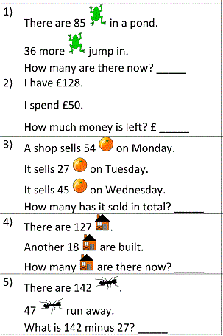
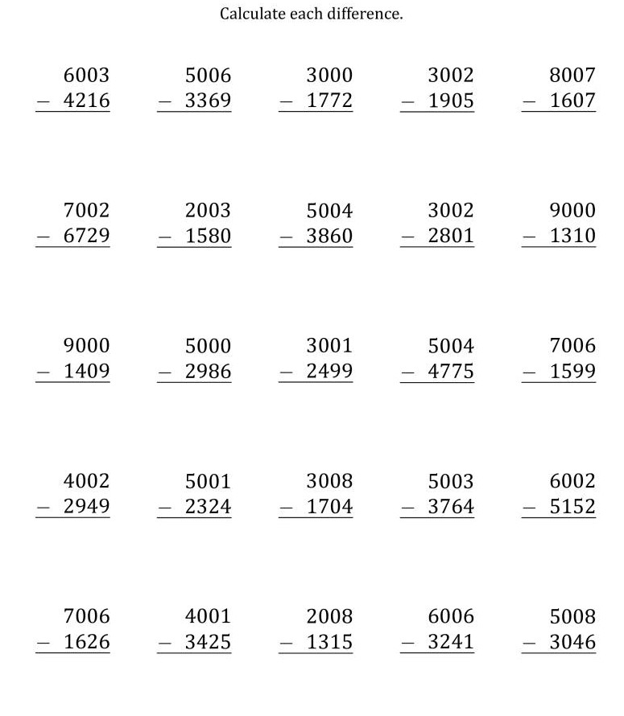
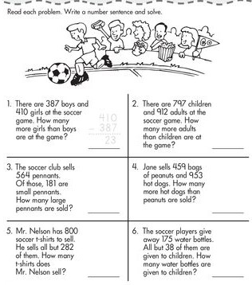
TEST YOUR KNOWLEDGE
Worksheet-1
Worksheet-2
Worksheet-3

Slide 18
Learning outcomes
By the end of the chapter student students should be able :
To differentiate between addition and subtraction.
To solve bigger subtraction with re-groupings.
Helps them to find different ways of subtraction.
To solve problems with their day to day activities.

Slide 19
THANK YOU

